Slide 1

Hardware Design Flow

Slide 2
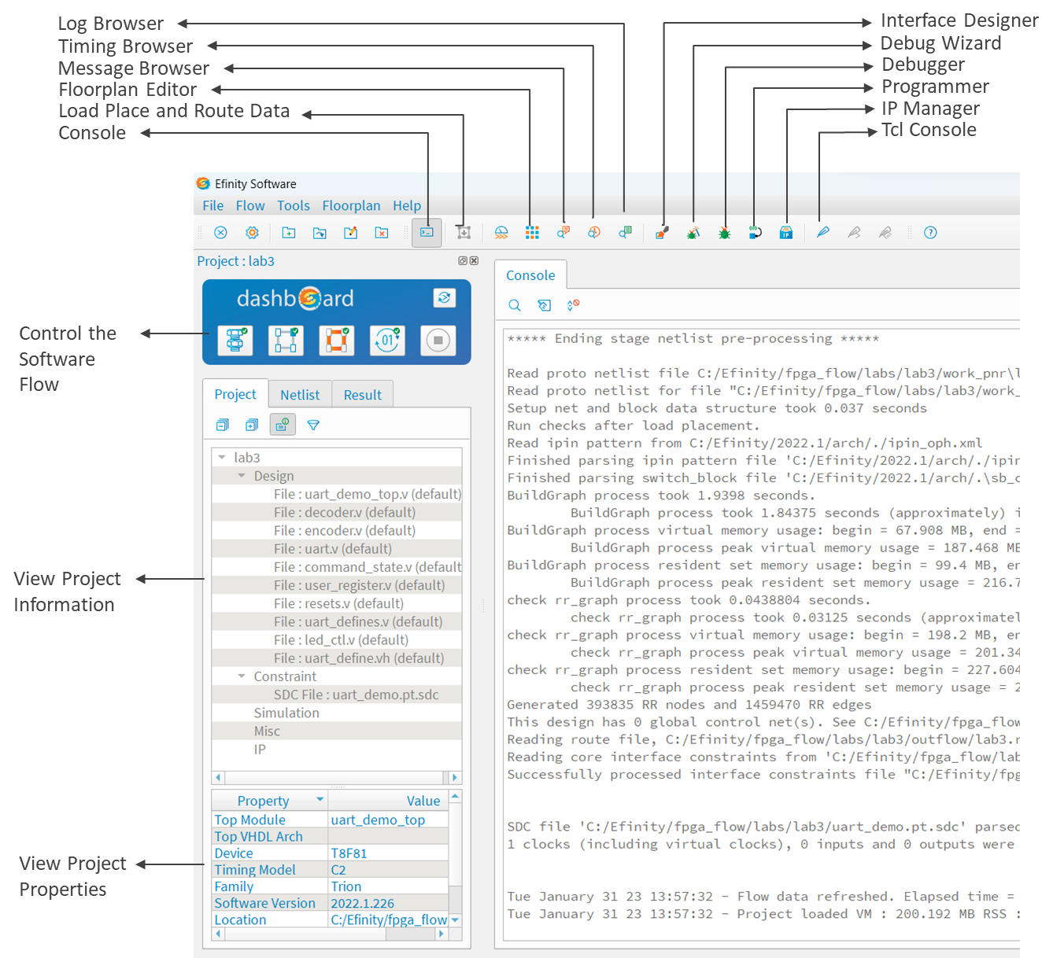
Efinity Main Window
Use the controls in the Dashboard to run the tool flow, including synthesis, placement, routing, and bitstream generation.

Slide 3
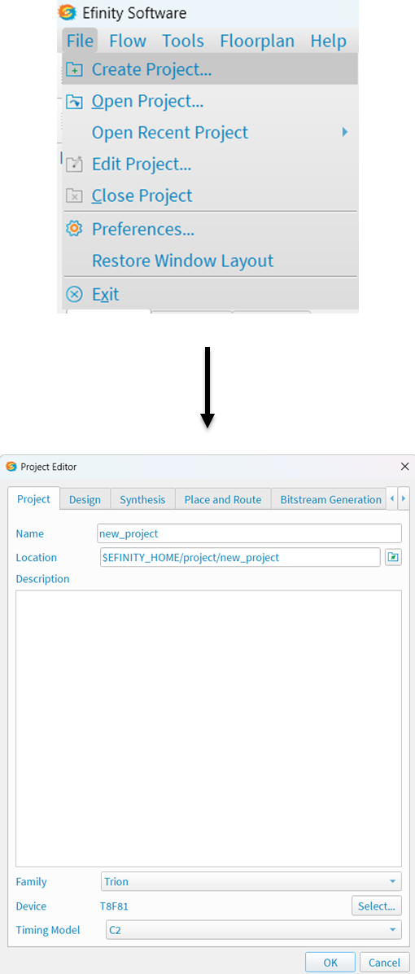
Project Editor – Project Tab
You use the Project Editor to create or modify a project, add files to your project (such as timing constraint files), and choose a device family and device. To create a new project, choose File > Create Project or click the Create Project icon.

Slide 4
Use the Project tab to specify the project name, location, optional project description, device family, device, and timing model. The project location defaults to <install directory>/ project/<project name>.

Slide 5
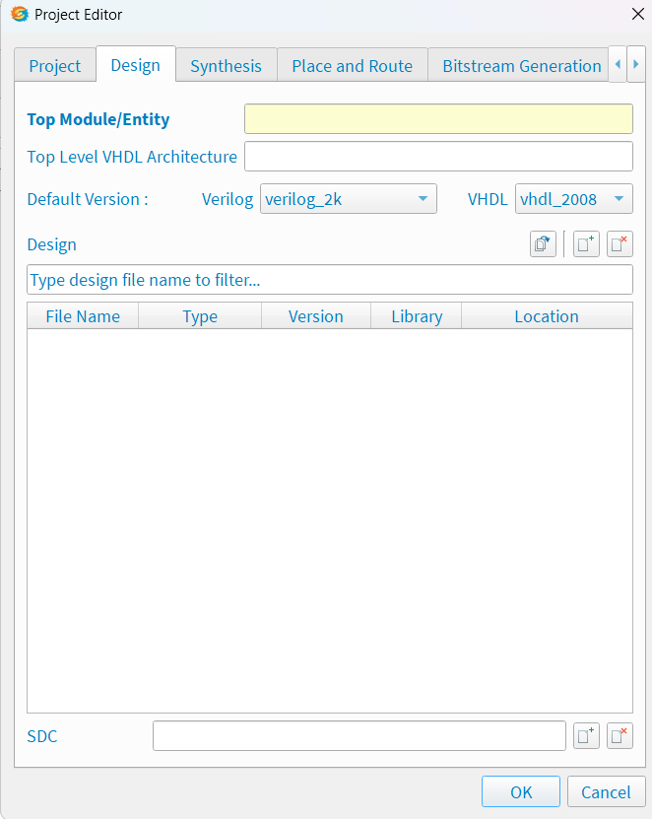
Project Editor – Design Tab
Use the Design tab to add design and constraint files to your project. You can also indicate the design’s top-level module; if you do not specify one, the tool attempts to determine it automatically.
You can choose the top-level VHDL architecture, if desired.

Slide 6
Project Editor – Design Tab cont’d
You can set the default Verilog HDL, SystemVerilog, or VHDL version for the design files.
In Efinity® v2020.2 and higher, you can define VHDL libraries and add files to them

Slide 7
Project Editor – Design Tab cont’d
You can import an entire directory of files into your project or add them one at a time. When you import files:
Turn on Copy to Project to copy the imported files to your project directory. You can choose whether to flatten (copy all files to project root directory) or preserve the directory structure.

Slide 8
Project Editor – Design Tab cont’d
If you do not copy the files to your project, specify whether to reference the files as full or relative paths.
Choose to import only design files or all files (which includes constraints).
Optionally, you can specify a Synopsys Design Constraints (.sdc) file for timing-driven compilation

Slide 9
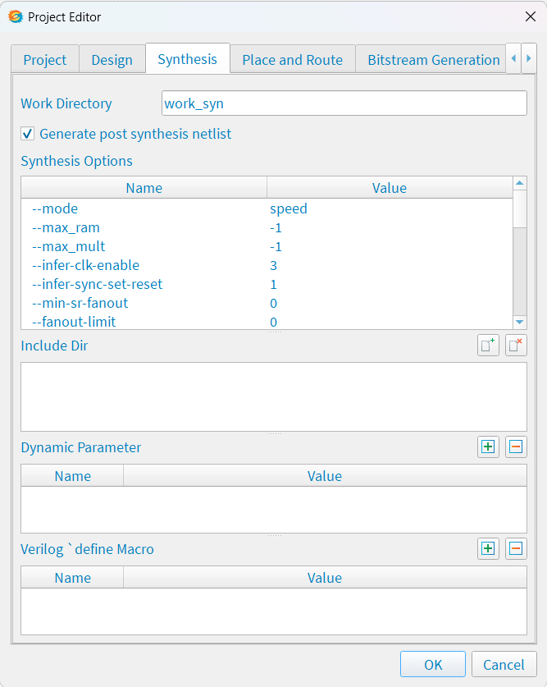
Project Editor – Synthesis Tab
Optional. The Efinity® software supports options to help you direct the synthesis flow. Use the options on this tab to specify project-specific preferences. If you do not make any settings, the tool uses the defaults.
Work Directory: Specify a custom directory or use the default (work_syn).

Slide 10
Project Editor – Synthesis Tab cont’d
Generate post synthesis Netlist: Choose whether the software should create this netlist. Default: On
Synthesis Options
Include Dir: Specify directories to include in your project. If you use the IP Manager to add IP, the ip/<module> directory is listed here. The software searches these locations when you use include statements.

Slide 11
Project Editor – Synthesis Tab cont’d
Dynamic Parameter: Use this area to add parameters and values that apply to the top-level module ornentity in your Project.
Verilog define Macro: Use this area to add define macros to your project. Some FPGA EDA tools automatically create a SYNTHESIS macro. If you want to use the same behavior in the Efinity software, you need to create it here.

Slide 12
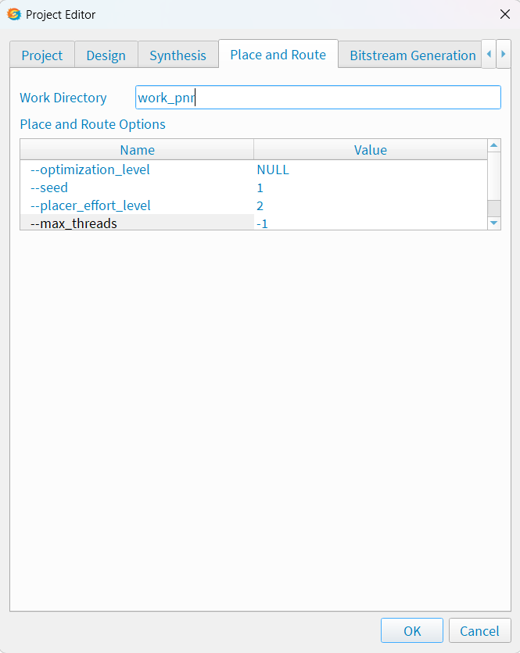
Project Editor – Place and Route Tab
Optional. The options on this tab let you specify project-specific preferences to help close timing. If you do not make any settings, the tool uses the defaults.
The optimization levels (-optimization_level) are settings that control both placement and routing, targeting different metrics.
— CONGESTION optimization levels may help a congested design meet timing.
— TIMING optimization levels may help a non- congested design meet timing requirements.
— POWER optimization levels may help reduce a design’s power consumption.

Slide 13
Project Editor – Place and Route Tab cont’d
The placer effort level (-lacer_effort_level) is a way to control how much runtime the placer uses when it tries to improve placement quality.
The number of threads (--max-threads) controls how many thread that the placer can launch. The default setting (-1) means that the placer uses the maximum number of available processors.
The --seed option introduces random noise in the placer. The seed is the value you set.

Slide 14
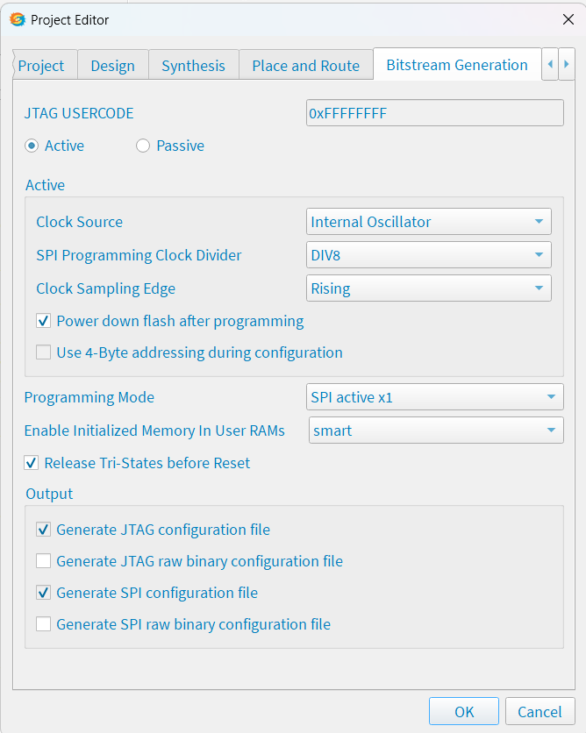
Project Editor – Bitstream Generation Tab
Optional. Use the options on this tab to specify project-specific preferences such as the programming mode, daisy chaining, and memory initialization. If you do not make any settings, the tool defaults to SPI active programming mode.

Slide 15
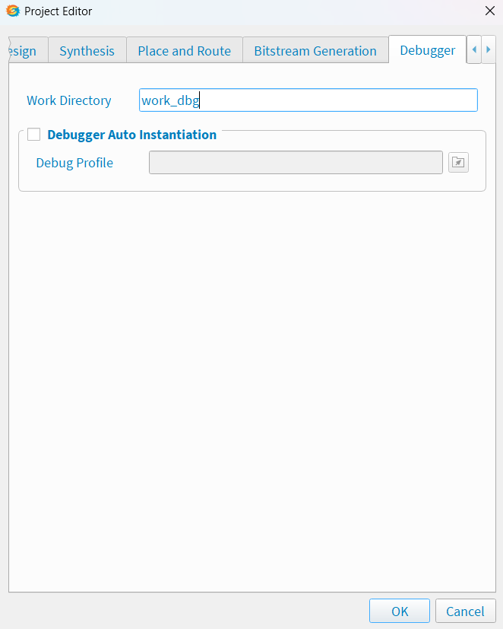
Project Editor – Debugger Tab
Optional. This tab is where you enable or disable a debug profile to auto-instantiate in your design and set a working directory for debugging. These settings are used with the Debug Wizard.

Slide 16
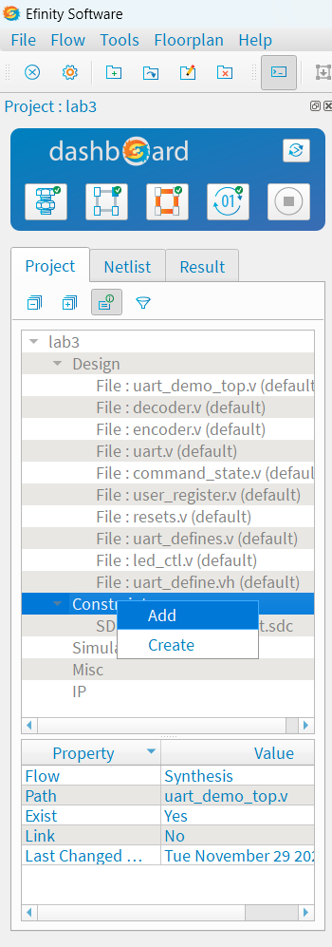
Project Pane
The Project pane, which is located under the Dashboard, shows all of the files in your design. Double-click a filename in the Project pane to open the file in the Efinity® Code Editor.
You can right-click the folders in the Project pane to open a context-sensitive menu with shortcut actions.

Slide 17
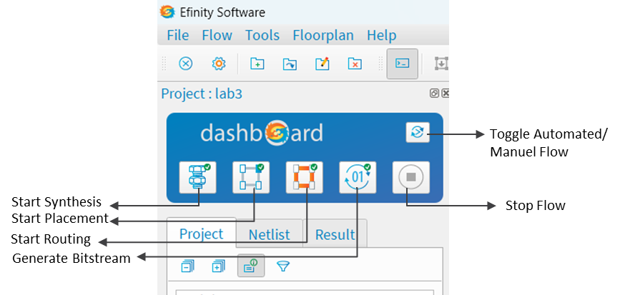
Run the Flow with the Dashboard Controls
The Dashboard controls the software flow, which operates in two modes: automated and manual. Toggle automated and manual flows using the toggle button.
Automated flow: Use automated mode to run the full flow from start to finish. Additionally, you can start the flow from any point and run it to the end.
Manual flow: Disable the automated flow to run each stage manually.

Slide 18
About Efinity Synthesis
The first stage after you complete your RTL design is synthesis. During synthesis, the compiler takes your design and turns it into a gate-level netlist. The software supports synthesis options and attributes so you can optimize your design.
The software supports the synthesizable subset of the following languages:
SystemVerilog and Verilog HDL
VHDL
Mixed languages (any combination of the above)

Slide 19
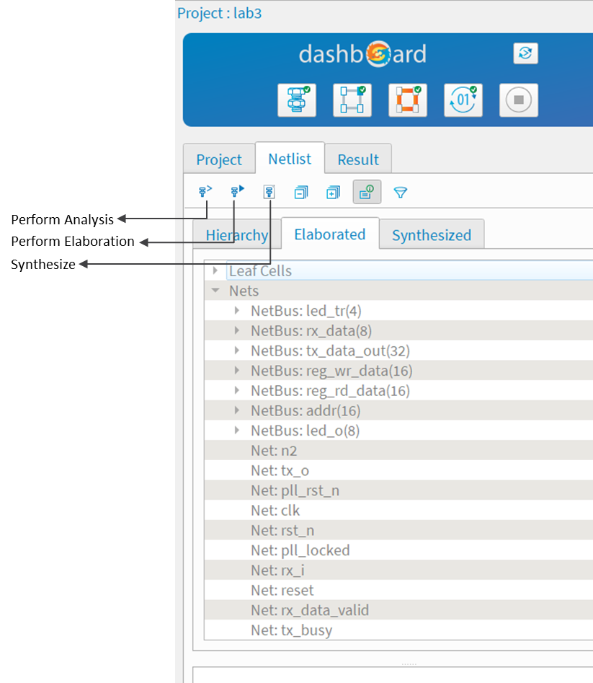
Netlist Pane
The Netlist pane, which is under the Dashboard, shows the design hierarchy and helps you browse through the elaborated design and synthesized netlist.
You can right-click the items in the Netlist pane to open a context-sensitive menu with shortcut actions.

Slide 20
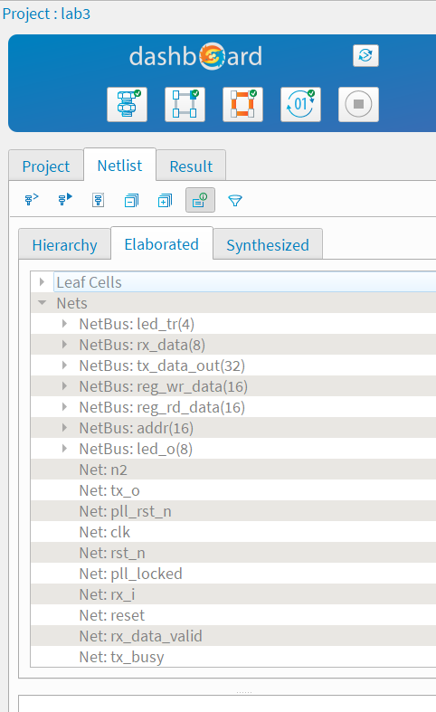
Viewing Messages and Logs
The Efinity software has several methods for viewing messages and log entries that result from the compilation flow.
Console: The Console provides verbose messages and reports for all aspects of the tool flow. Additionally, it functions as the Tcl message console when you turn on the Tcl Command Console.
• You can clear the Console and remove all messages.
• You can prevent the Console from scrolling when the tool issues new messages.

Slide 21
Viewing Messages and Logs cont’d
Message Browser: The Message Browser gives synthesis-specific messages that result when you elaborate the netlist.
Timing Browser: The Timing Browser shows the critical paths in your design.

Slide 22
Log Browser: The Log Browser gives you a way to sort and browse through all of the messages resulting from the compilation flow.
It shows some of the same content as the Console (the Console is more verbose). You can filter by where the message appeared in the flow (synthesis, placement, routing, programming) and the type of message (info, warning, or error).
The Log Browser lets you search messages using keywords or regular expressions.

Slide 23
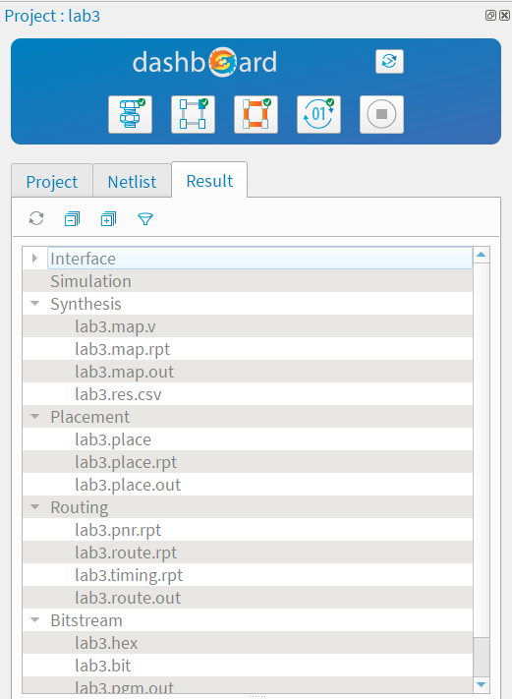
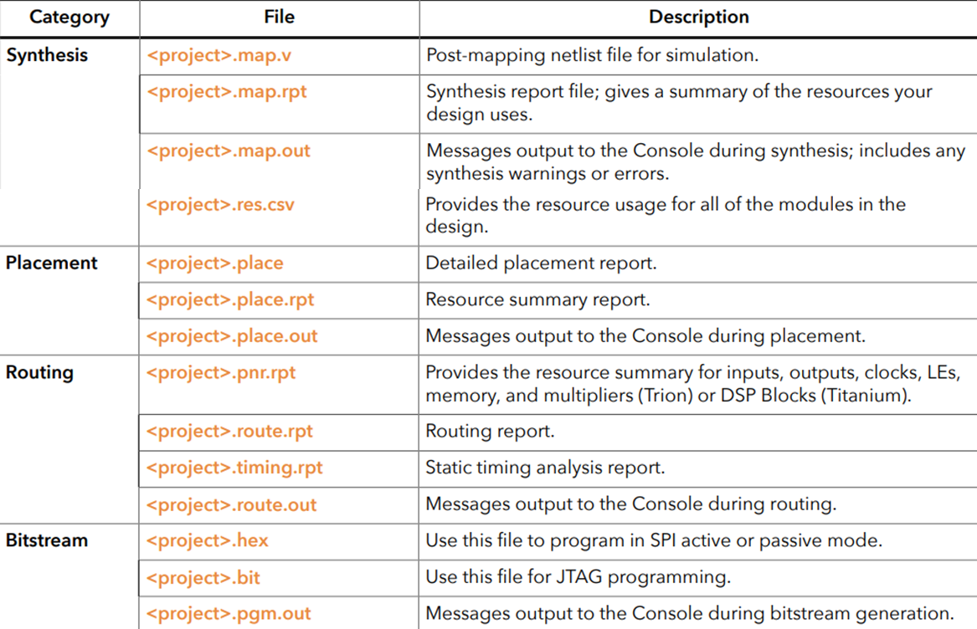
Result Pane
The Result pane, which is under the Dashboard, shows all of the reports and files that result from compilation. Additionally, it shows a summary table of the resources used.

Slide 24
Viewing Place-and-Route Results
You view place-and-route results in the Console pane, in the Result pane, and in the Floorplan Editor.
The Console displays messages generated during compilation. For example, if the design has too many I/O pins to fit in the target device, compilation will stop and the Console will show the error message.
The Result pane shows the output and report files for each stage in the flow. Additionally, the Report pane displays a table of the interface resources the design uses; if your design has a debug core, it also shows a table of resources used by the debugger.

Slide 25
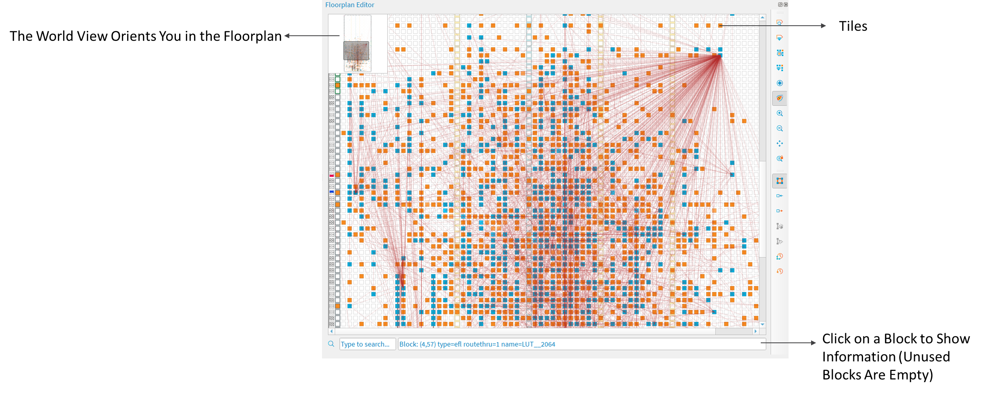
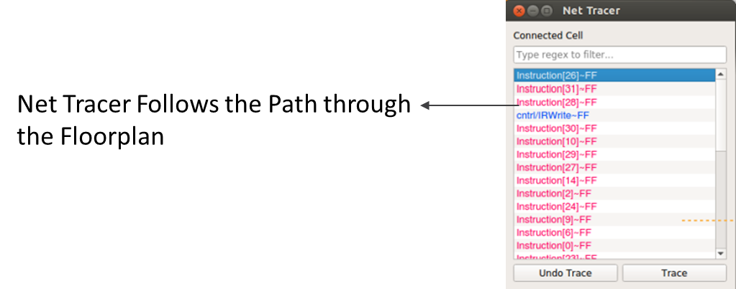
Viewing Place-and-Route Results
After you have run a project through synthesis, placement, and routing, you can open the Floorplan Editor tool to see a representation of the tiles in the FPGA and the placement of logic, memory, I/O, and other blocks. Click the Floorplan Editor icon in the main toolbar to open the Floorplan Editor.

